Slide 1
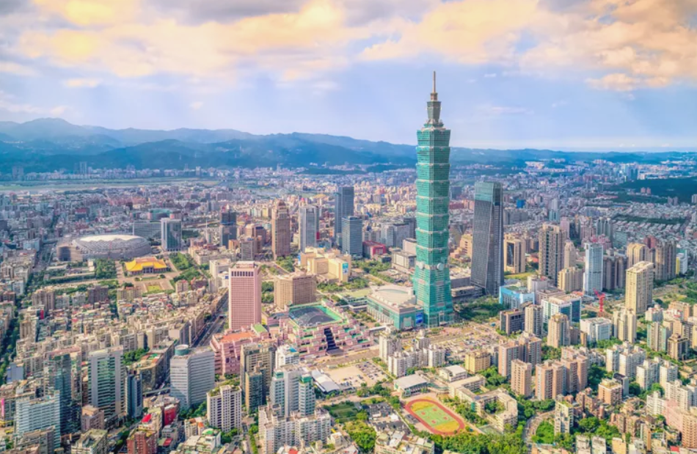
Time to Explore Taiwan
Clustering Analysis on Taipei Districts

Slide 2
INTRODUCTION
‘Isla Formosa’ – Taiwan, is a beautiful island that has been famous for diverse traditions, culture and delicious food. There are so many things people can explore when they visit Taiwan. It would be nice to have a map to show what districts share the similar characteristics so people can easily visit the places where fit their interest.
This analysis will be based on k-means clustering model to segment Taipei districts and make recommendation for on places to go based on cluster outcome.

Slide 3
Data and methodology
Data Sources:
Foursquare API to pull venues data on Taipei area.
There are 567 venues returned among the 41 Taipei districts
Taipei geolocation data.
There are 41 districts with latitude and longitude information in the dataset.
Cleaned and merged the two datasets and summarized the data at district level give us 39 districts with 130 venue categories for clustering
Methodology:
Apply K-Means clustering to segment the districts
Use the elbow method to find out the optimal K
According to the result, K=4 is the optimal cluster number we should use. Therefore, for the model, I created 4 clusters for the 39 districts
*Please refer to appendix for data sample and EDA result

Slide 4
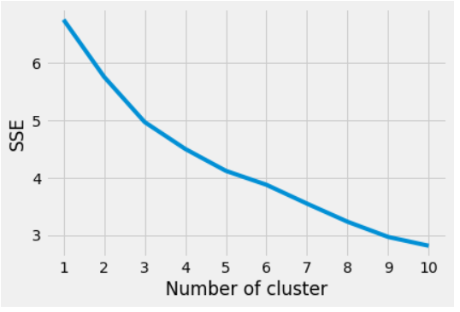
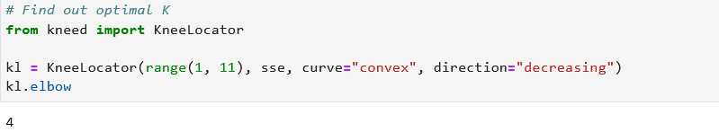
Model Process
K-Means clustering is the model use for the clustering
We use elbow method to find out the optimal K
Given the graph is hard to determine the elbow point, we use programmatical way to find out the optimal k = 4
This suggests us to segment the 39 districts into 4 clusters

Slide 5
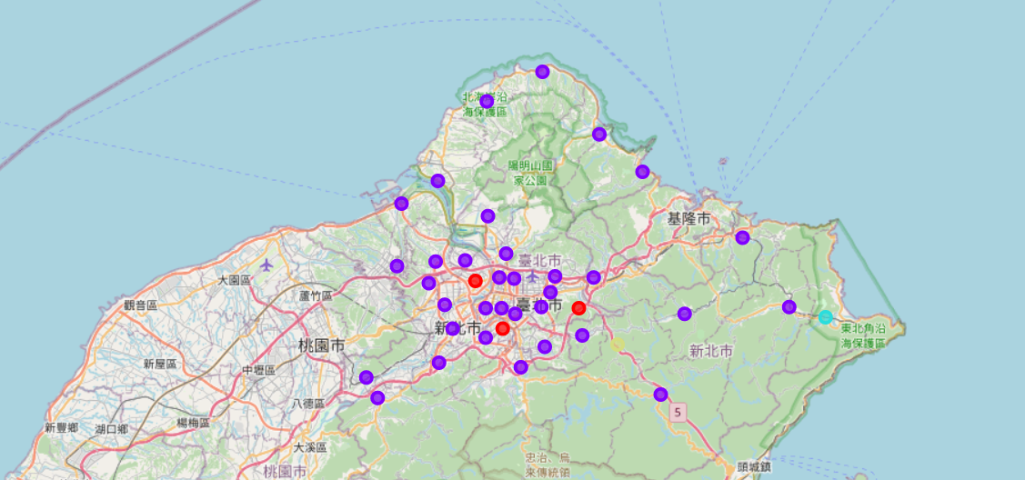
Clustering RESULT
The clustering result shows there is 1 cluster that include most of the districts.
When further look into each cluster, we can identify the common theme and assign a name for each cluster

Slide 6
Result Discussion
There are 4 segments we can grouped based on the 39 districts we have originally
Cluster 1 – Residential: The top venues for this cluster is convenience store and supermarket. The conveniency is good for local people where they can easier get the grocery they need
Cluster 2 – Food Explorer: This is the largest segment k-mean cluster identified. The top venues associated with the segment are the various restaurants, from Taiwaness to seafood. These districts could be attractive for tourists who like food and open to explore different kind of cuisine
Cluster 3 – Culture and Outdoor: The top venues show up for this district is the train station (which is a historical old train station full of culture and history) and the water park. The district can attract tourist who like to learn the culture and enjoy outdoor activity
Cluster 4 – Shopping: The top venues for the district are restaurant, department store. This could be a good place to visit for tourists who like to shop and enjoy having a good meal after shopping
*Please refer to appendix for cluster result

Slide 7
Conclusion
Taiwan is such a beautiful and diverse place for people to visit. After completing the project and create cluster for the districts, it enables tourists to find what place to go more easier based on their interest. They can enjoy delicious food, explore outdoor scenery or shopping.
The K-Means clustering suggests segment the districts into 4 segments. In the future, there are opportunity to use different clustering model to explore whether finer segment needs in order to be more specific on grouping the districts.

Slide 8
Appendix

Slide 9
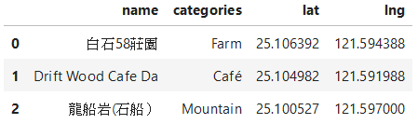
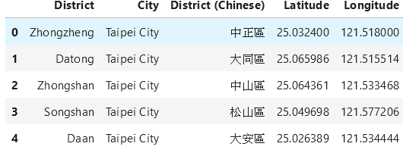
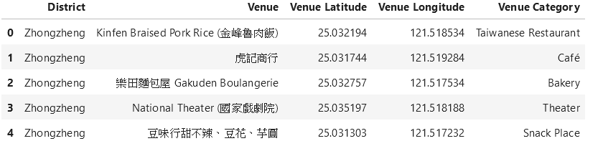
SAMPLE DATASET
Table 1: Foursquare venue data
Table 2: Taipei geo location data
Table 3: Analysis data

Slide 10
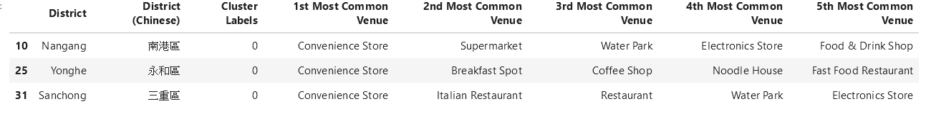
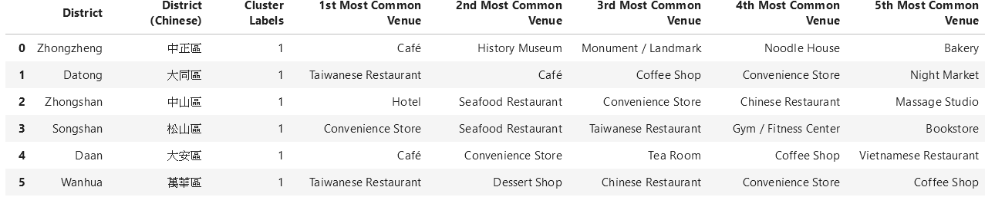
Cluster result – 1&2
Cluster 1: Residential Area
Cluster 2: Food Explorer

Slide 11
Cluster result – 3 & 4
Cluster 3: Culture and Outdoor
Cluster 4: Shopping and Foodie

